Slide 1
Addressing systematic error using the algorithmic leviathan

Slide 2
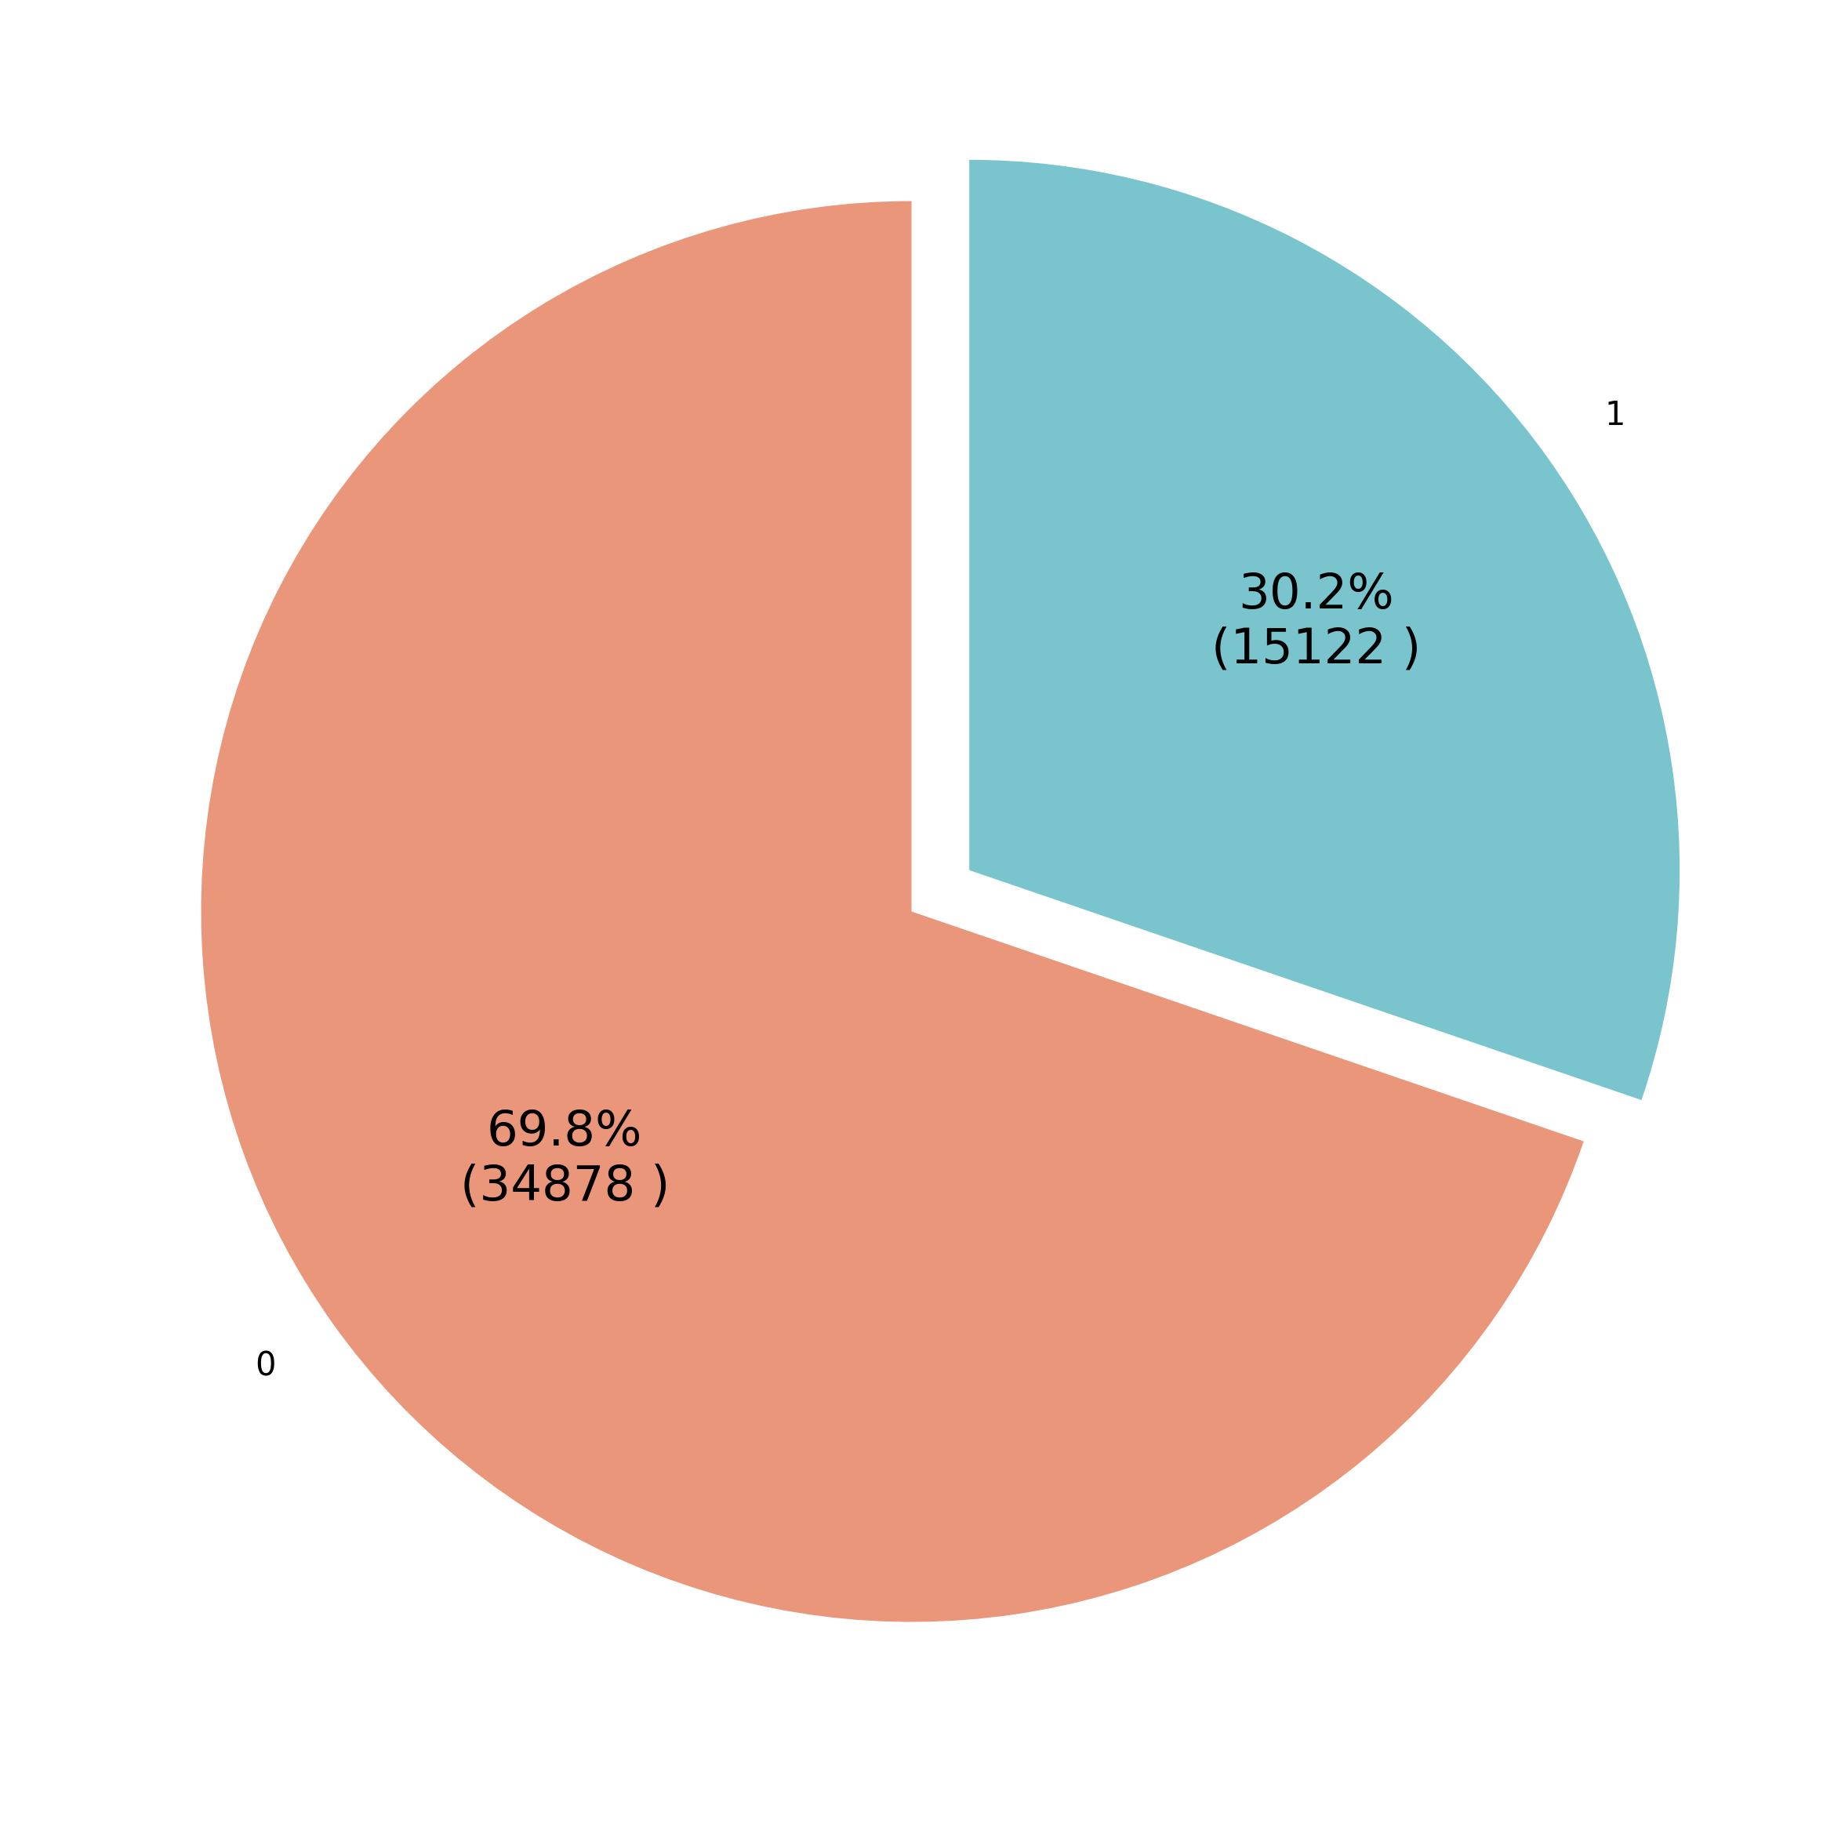
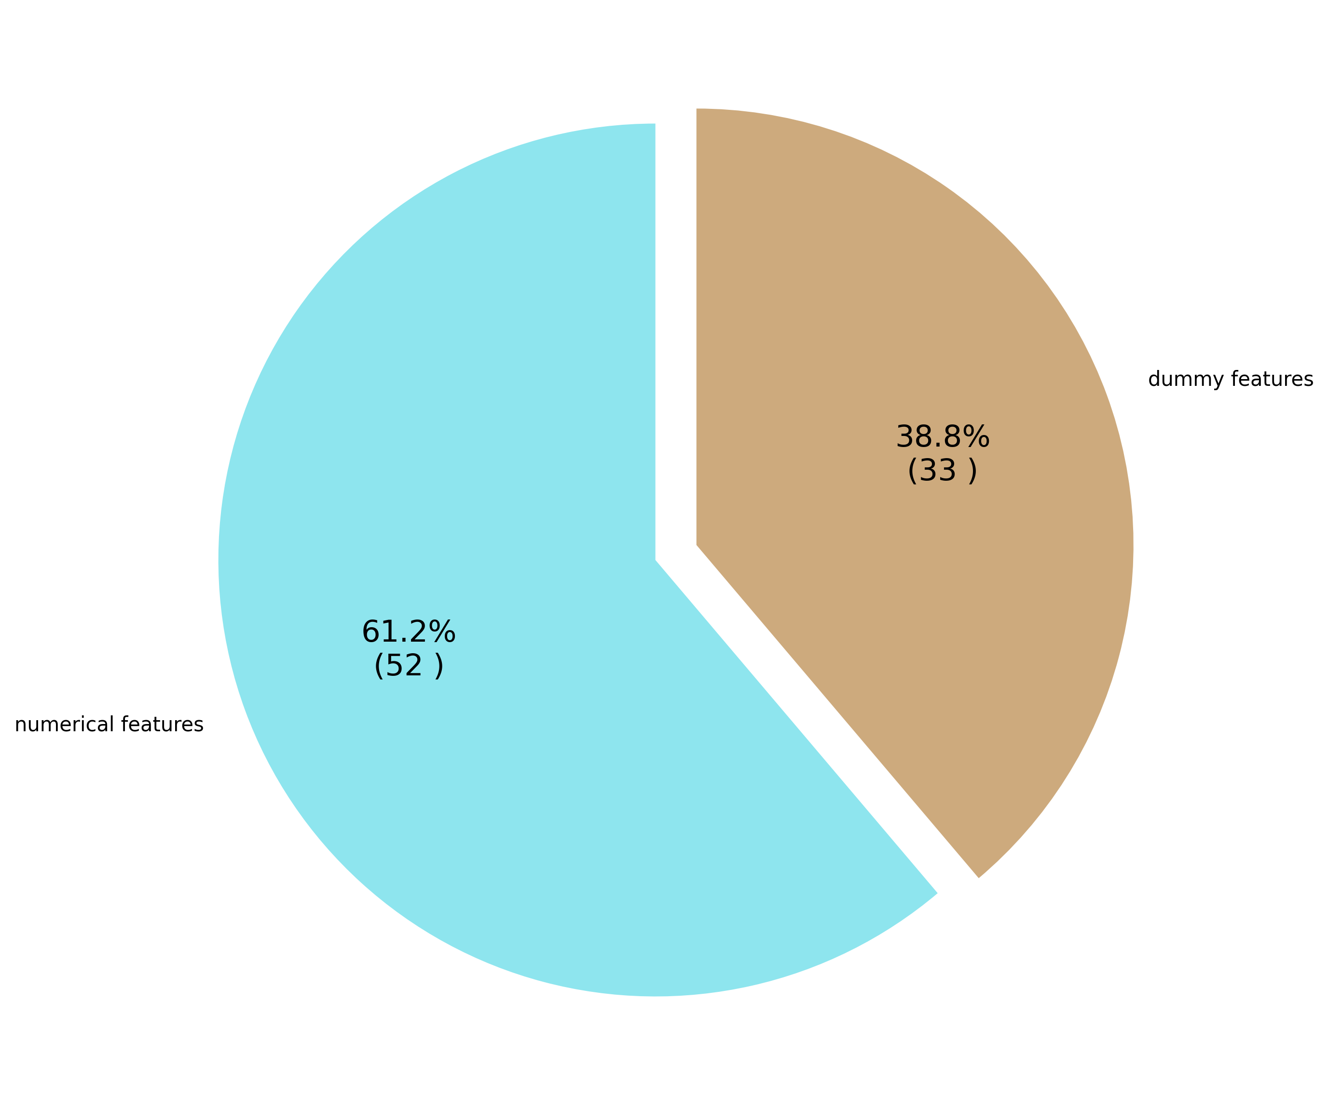
Data exploration
Hired
Coded
categorical
features
Numerical
features
Not hired
Notes:
Hired
Not Hired

Slide 3
Address systematicity
Address systematicity
Different models
Features sampling
Introduce randomness
Add Gaussian to prediction
population sampling
Algorithms

Slide 4
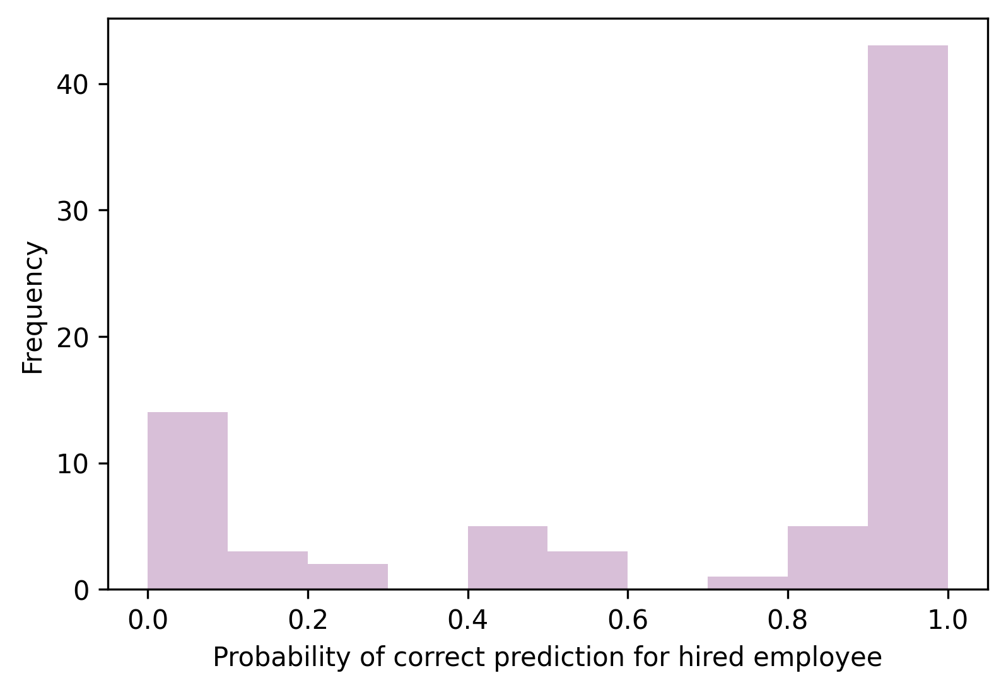
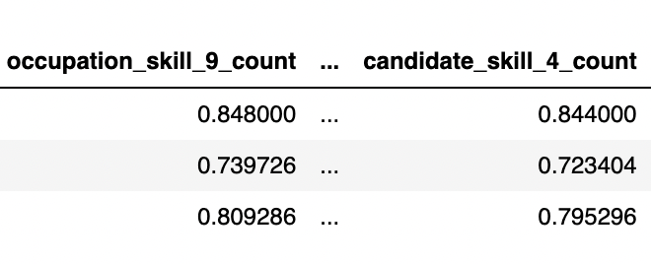
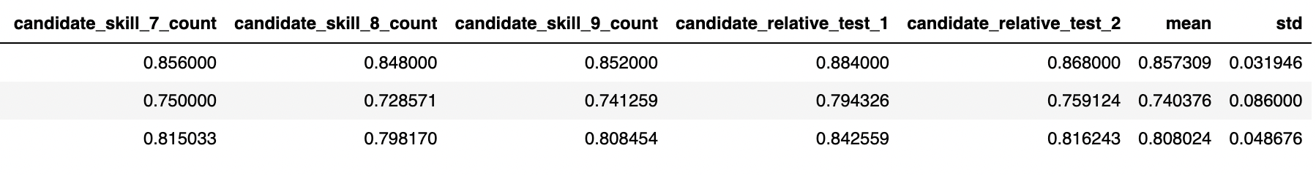
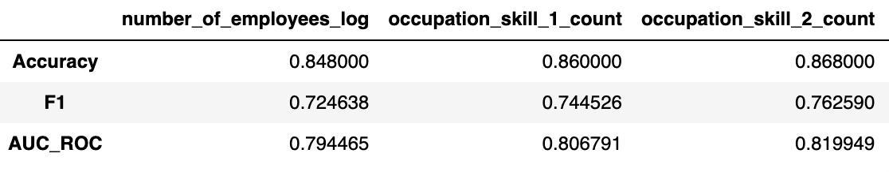
Feature sampling: Introduce arbitrariness by withdrawing features
For 55 models:
4.8% percent of hired population were wrongly predicted by all models.
50.8% of hired population were correctly predicted all the time.

Slide 5
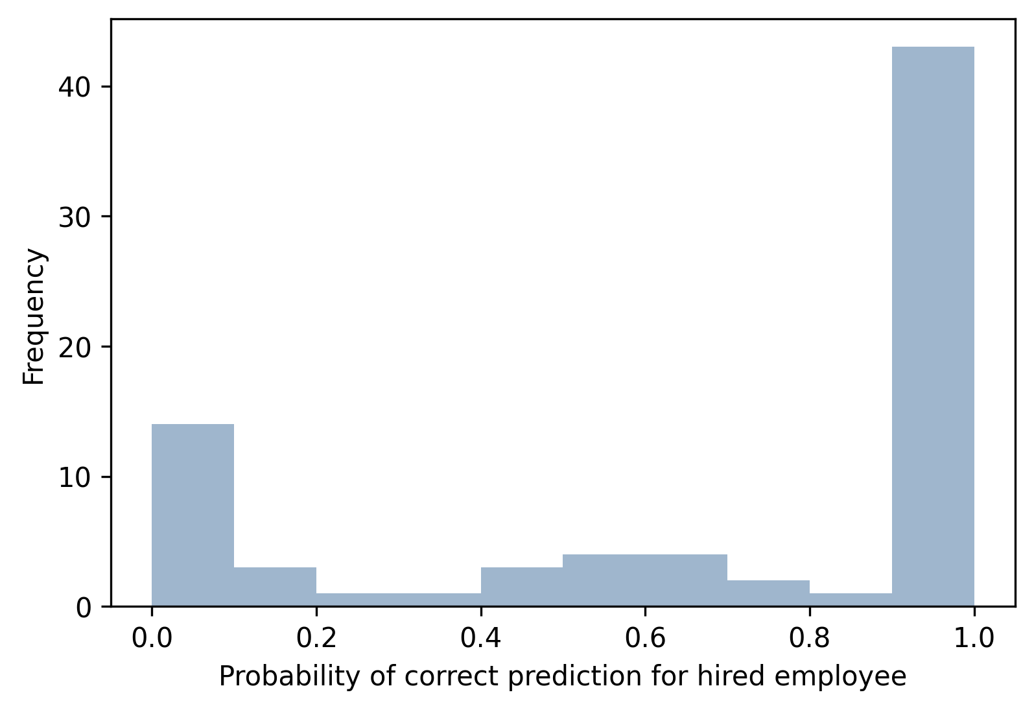
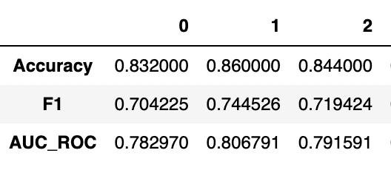
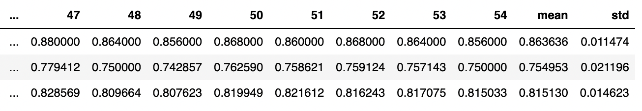
Population sampling: Introduce arbitrariness by sample 90% data
For 55 models:
3.6% percent of hired population were wrongly predicted by all models.
68.4% of hired population were correctly predicted all the time.

Slide 6
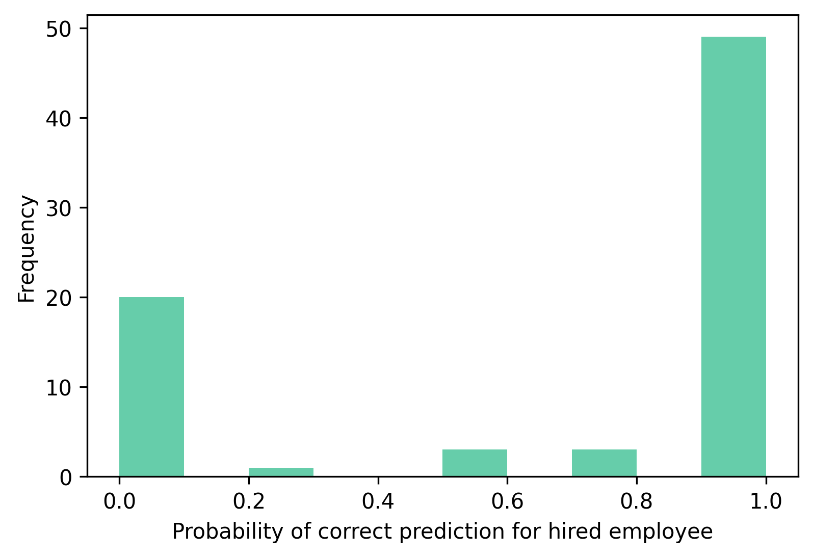
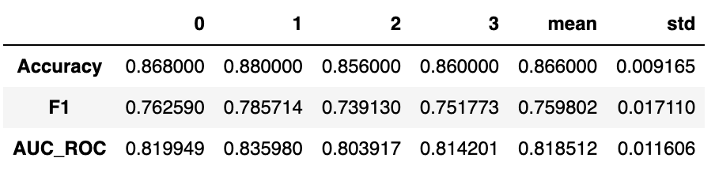
Algorithms: Different boosting classifiers
For 4 models:
10% percent of hired population were wrongly predicted by all models.
82.8% of hired population were correctly predicted all the time.

Slide 7
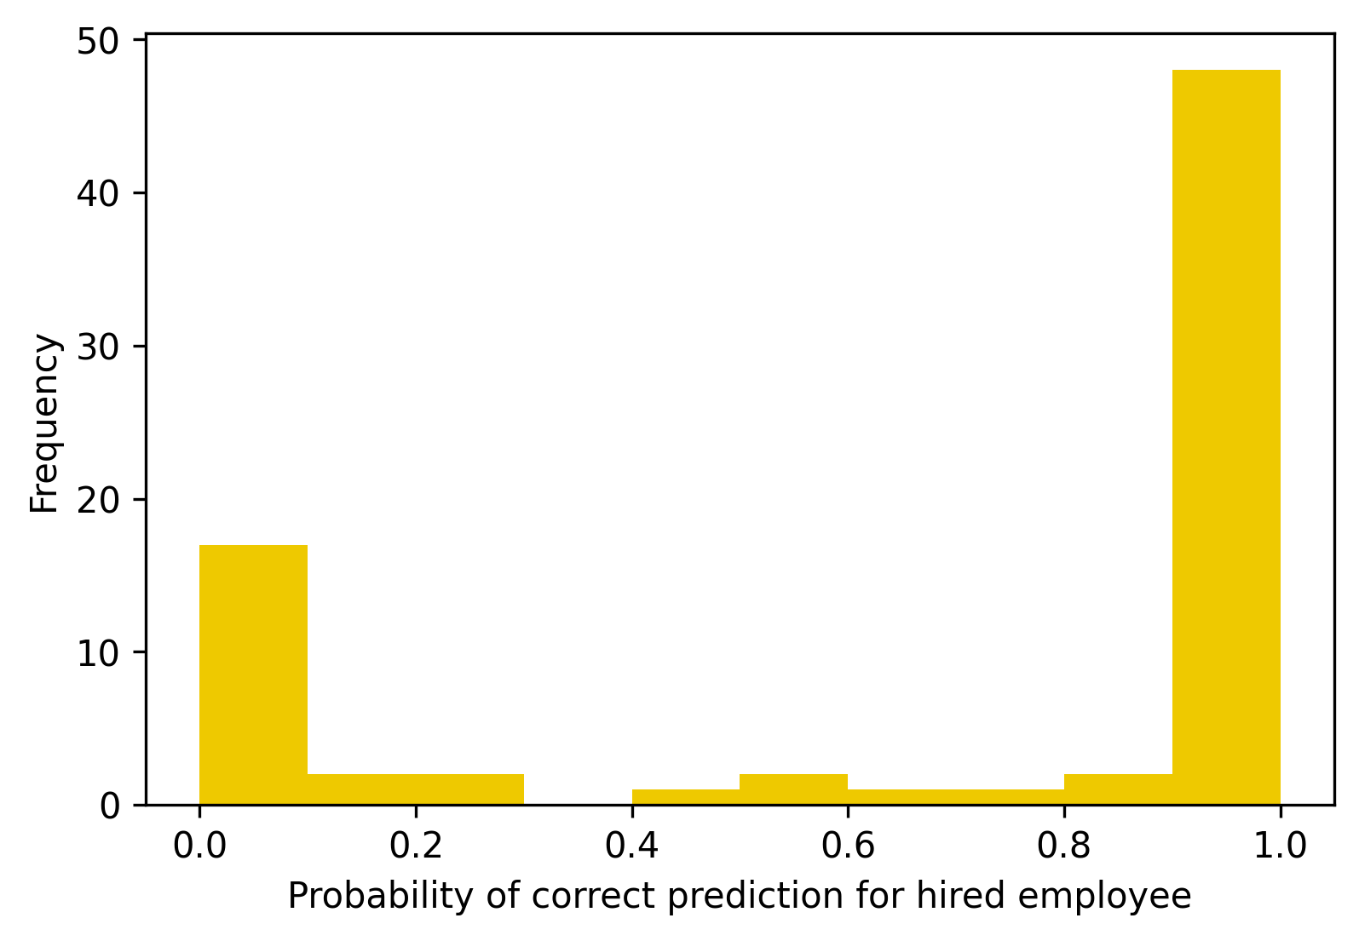
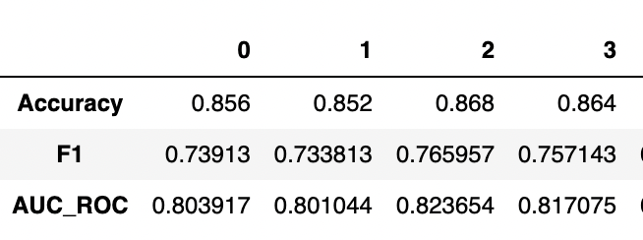
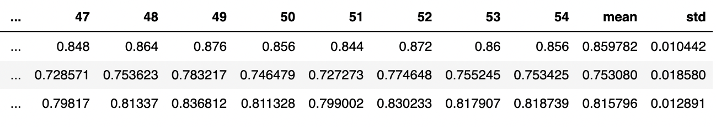
Introduce Randomness: Add a random number from Gaussian distribution to Y
For 55 models:
7.2% percent of hired population were wrongly predicted by all models.
75.6% of hired population were correctly predicted all the time.

Slide 8
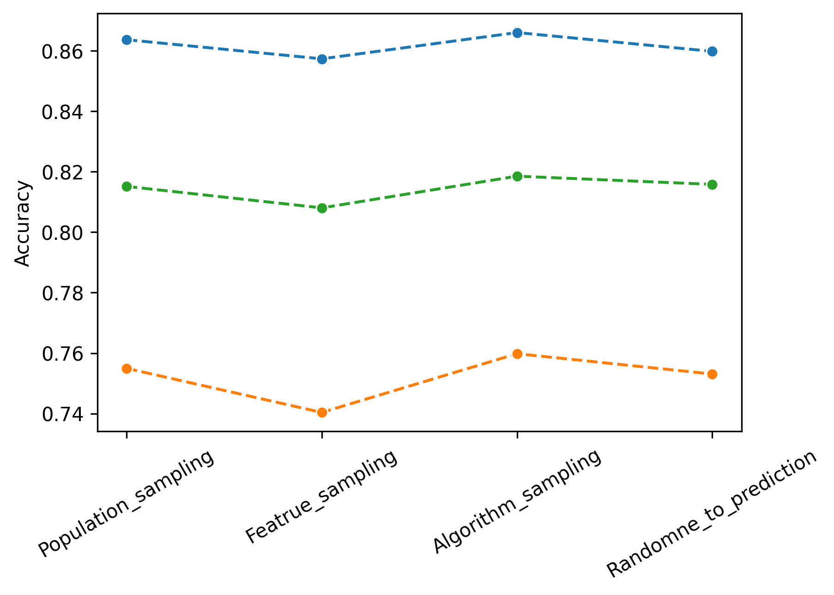
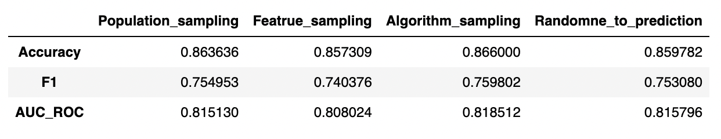
Comparison of performance
Accuracy
AUC_ROC
The four different method gives similar accuracy performance.
The trend is also consistent across methods
F1
Notes:
Accuracy
F1
AUC_ROC

Slide 9
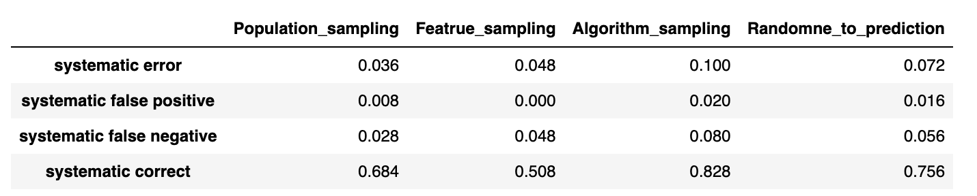
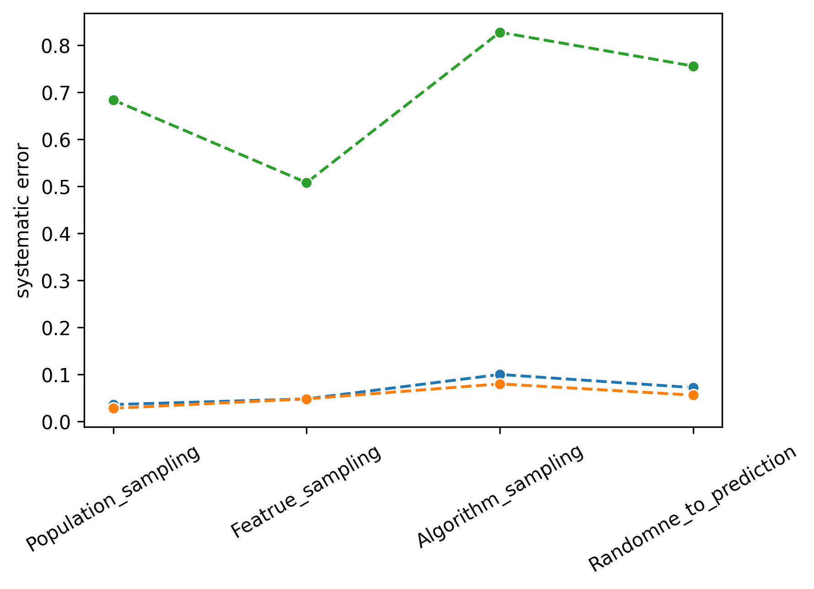
Comparison of performance
Systematic Correct
To minimize false negative, i.e all hired employee were predicted as hired in some model, population sampling has the best performance.
Population sampling also achieve lowest overall systematic error.
Systematic error
Systematic False negative
Notes:
Systematic error
Systematic False negative

Slide 10
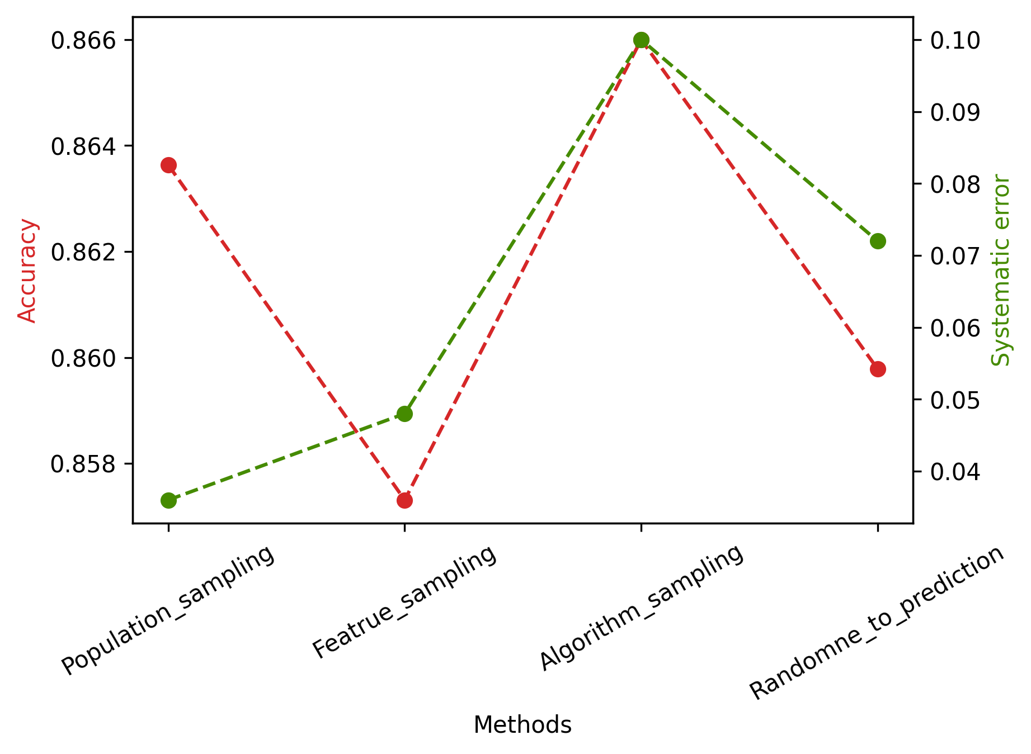
Comparison of performance
Population sampling may be a balance that maximize accuracy and minimize systematic error

